Slide 1

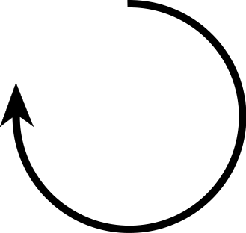

Geometric Transformations
2D and 3D

Slide 2
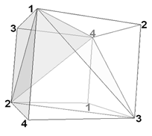

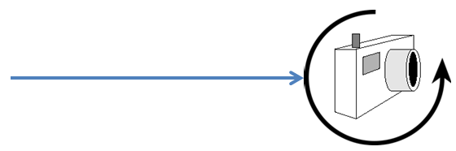
How do we use geometric transformations?
Objects in a scene are a collection of points
These points have location, orientation, size
A scene has a camera/view point from which the scene is viewed
The camera has some location and some orientation in 3-space
Correspond to Translation and Rotation transformation

Slide 3


Transformations
Process of mapping points to other locations
Common transformations
Translation (T)
Scaling (S)
Rotation (R)
Others
Reflection
Shear

Slide 4
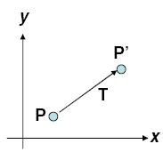
2D Translation
Move/translate/displace a point to a new location
In effect, moving original point position along a straight-line path to its new location
An object defined by multiple coordinate positions
Relocate all coordinate positions by same displacement along parallel paths
Every point on object is translated by same amount
Rigid-body, moves object without deformation

Slide 5
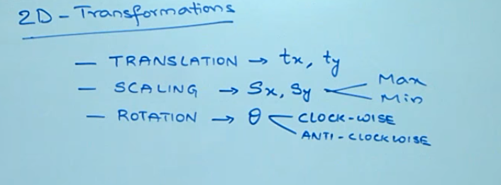

Slide 6





2D Translation
To translate original coordinates (x, y) by translational distances t_{x} and t_{y} to obtain new coordinate position (x’, y’)
Equation in matrix form
P’ = P + T
P = Original position
P’ = New position
T = Translational vector

Slide 7
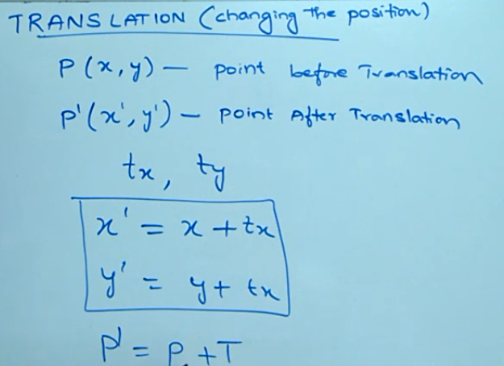

Slide 8
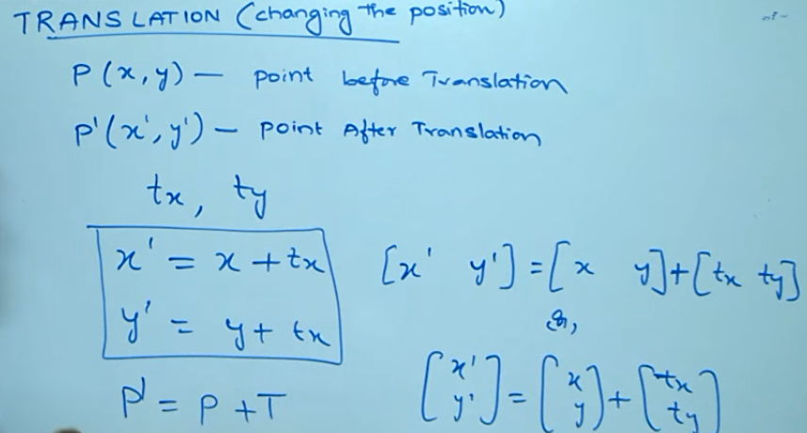

Slide 9



2D Scaling
To alter the size of an object
Expand or contract along each axis
Simple 2D scaling operation performed by
Multiplying original object positions (x, y) by scaling factor s_{x} and s_{y} to produce scaled coordinates (x’, y’)
Equation in matrix form
P’ = P • S
P = Original position
P’ = New position
S = Scaling vector

Slide 10
2D Scaling
Scaling factors
Less than 1 reduces size, greater than 1 increase size
Uniform scaling maintains relative object proportions
Equal scaling factors
As opposed to differential scaling (unequal scaling factors)
In some systems, negative values not only resize the object but reflects it about the perspective coordinate axes

Slide 11
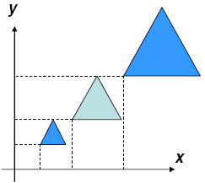


2D Scaling
Object transformed using simple scaling both scaled and repositioned
Scaling factors with absolute values less than 1 move objects closer to coordinate origin
Values greater than 1 move objects further

Slide 12
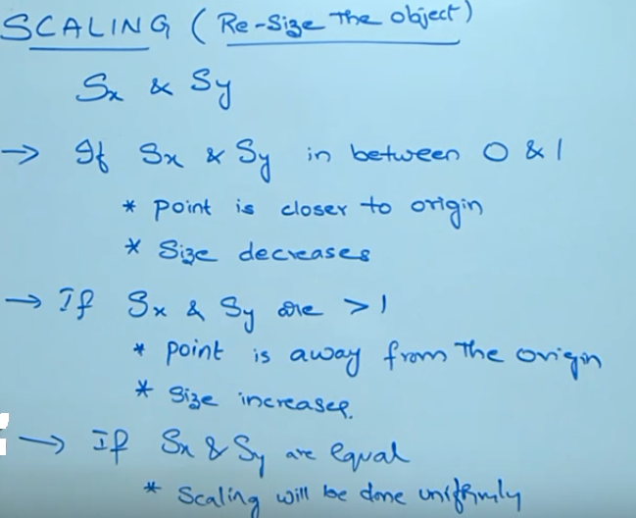

Slide 13
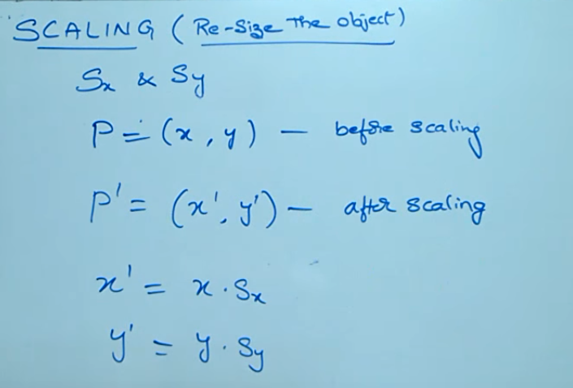

Slide 14
